Slide 1
CM Géo-Eco
LEA1 – UJML3 – 2020-2021
M. bourdeau

Slide 2
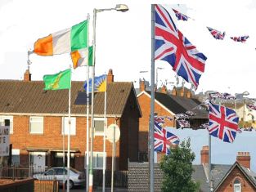
Part 6: Northern Ireland’s 'troubled’ history
M. Bourdeau UJML3 2020-2021

Slide 3
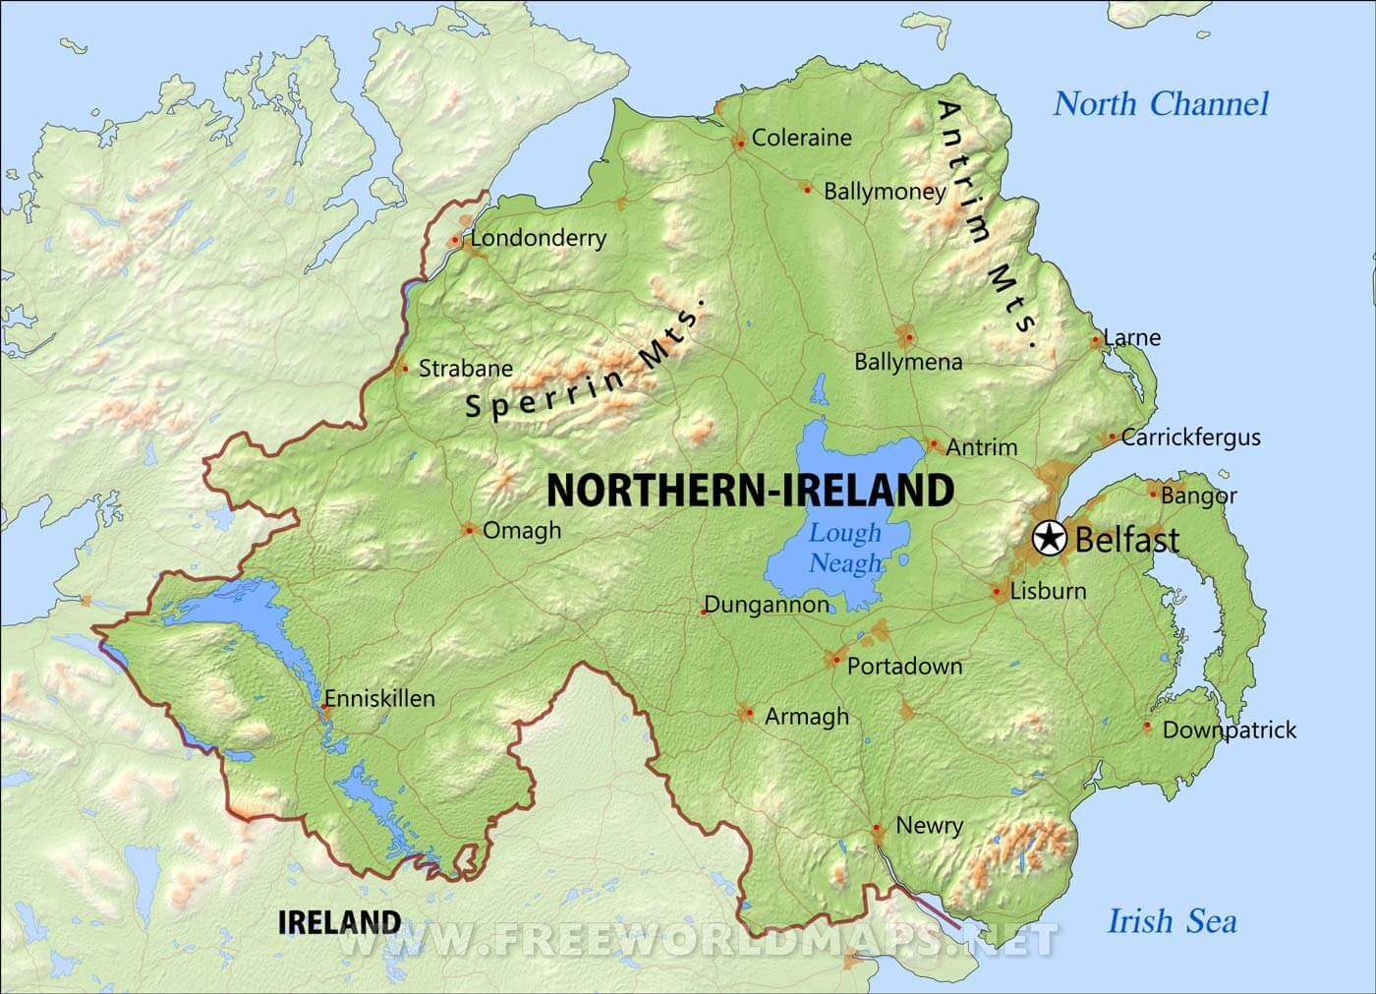
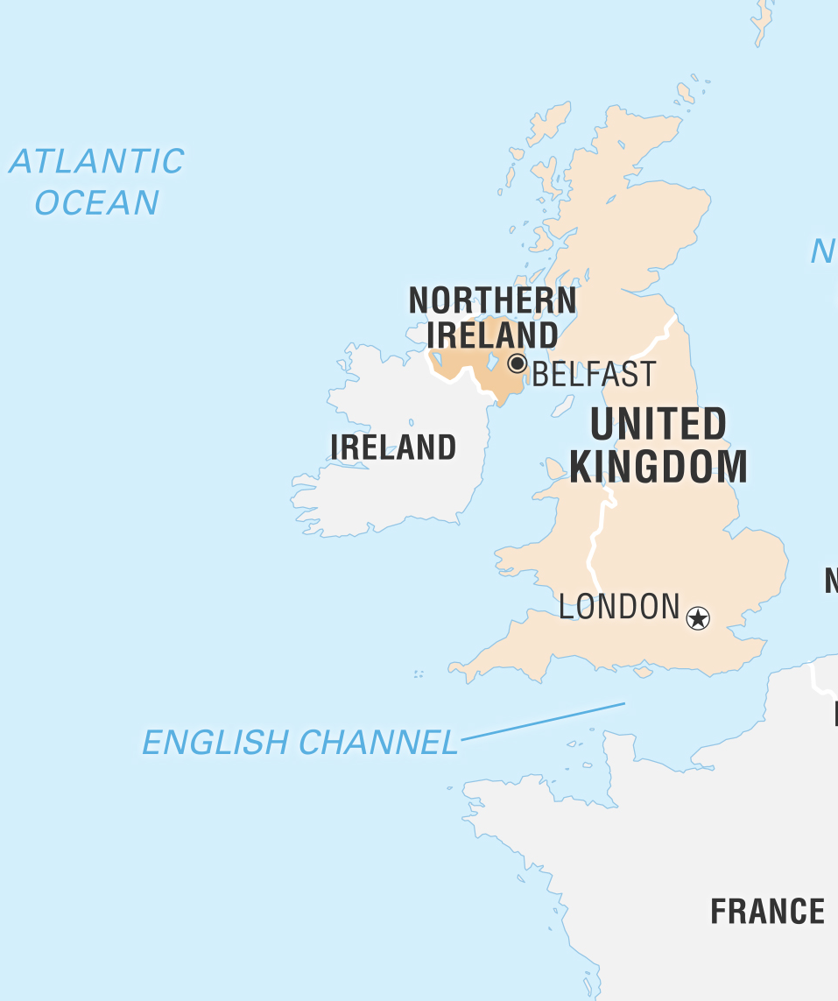
Basic facts about Northern Ireland
Capital: Belfast
Population: 1.9 million
Official language: English (controversial)
Irish name: Tuaisceart Éireann
Symbols = ?
M. Bourdeau UJML3 2020-2021
Notes:
/tu:ˈɪʃkæɾt/

Slide 4
Contents
1. Division(s)
2. The ‘Troubles’
3. What Future for Northern Ireland?
M. Bourdeau UJML3 2020-2021

Slide 5
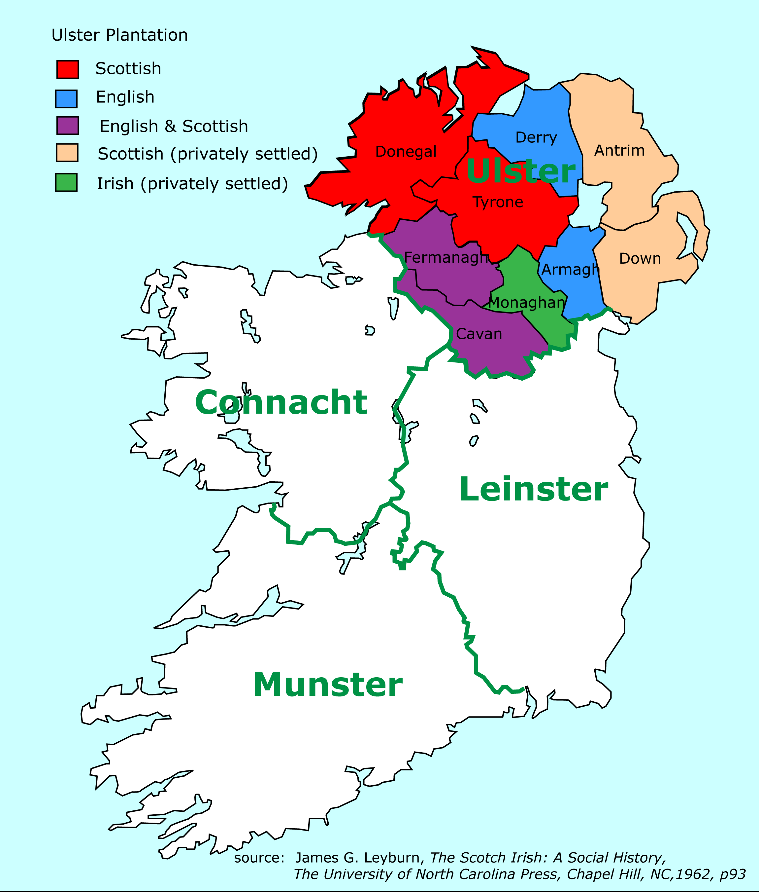
1. Catholics and/vs. Protestants
Invasions & colonisation
Henry VIII (1509-1547): self-proclaimed king of Ireland
James I (1603-1625): colonisation of Ulster by the English and the Scots
Nine Years’ War (1593–1603) against English rule => Irish defeat => “Flight of the Earls” (1607)
= ‘free’ land + will to eradicate Irish rebellion by controlling, anglicising and "civilising" Ulster => “Plantation of Ulster” (1609-end of 18th century)
Major pb: religion
Since 5th century: Catholic Ireland (syncretism with elements of Gaelic culture & identity)
Native Catholic Irish vs. immigrant Protestant English ppl and Scots
M. Bourdeau UJML3 2020-2021

Slide 6
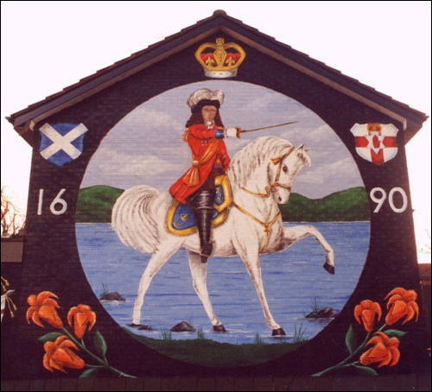
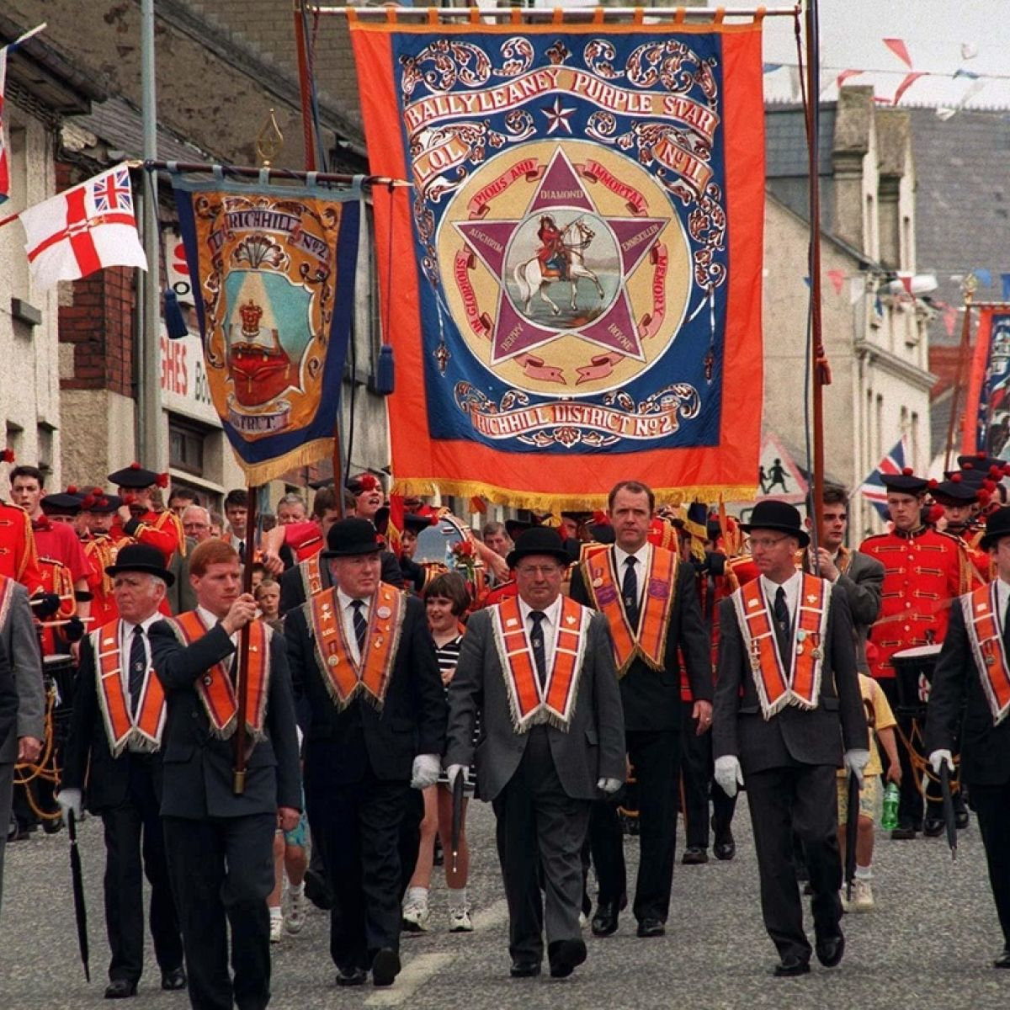
17-18th centuries: series of (failed) Irish rebellions to defend right to land, representation & religious freedom. Ex:
1641 Irish Rebellion
1690 Battle of the Boyne (July “Orange Marches”)
1798: Irish rebellions led by the United Irishmen
Systematic severe English/British repression
1801: Act of Union (to officially assert Eng. authority)
1830s & 1840s: failed attempts to repeal the Act of Union
M. Bourdeau UJML3 2020-2021

Slide 7
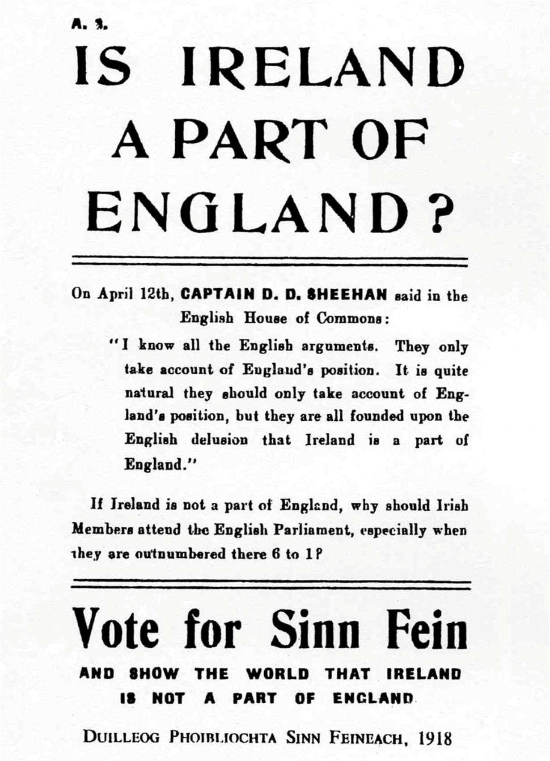
Home Rule
Island of Ireland: ”Home Rule” (indep self-gov) movement
dominant political movement of Irish nationalism from 1870 to the end of WWI
1886 and 1896: Home Rule bills defeated
1905: Sinn Féin created
1912: 3rd Home Rule Bill => Crisis in Ulster:
“Home Rule is Rome Rule”
Ulster Unionists wanted Ulster to be excluded from Home Rule plans: first mention of partition
Ulster Volunteer Force (UVF) (paramilitary) vs. Irish Volunteers
WWI= suspension of Home Rule process + weakened British power => Irish Republican Brotherhood (IRB) organised the Easter Rising (April 1916)
M. Bourdeau UJML3 2020-2021
Notes:
https://www.youtube.com/watch?v=722S-m6T7Hw

Slide 8
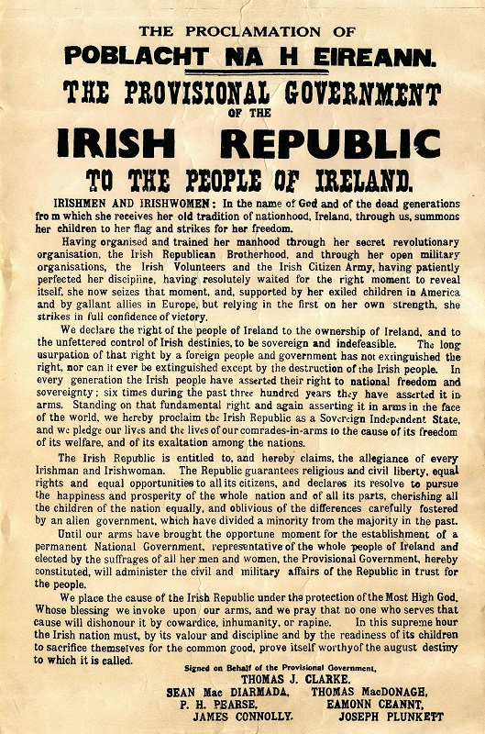
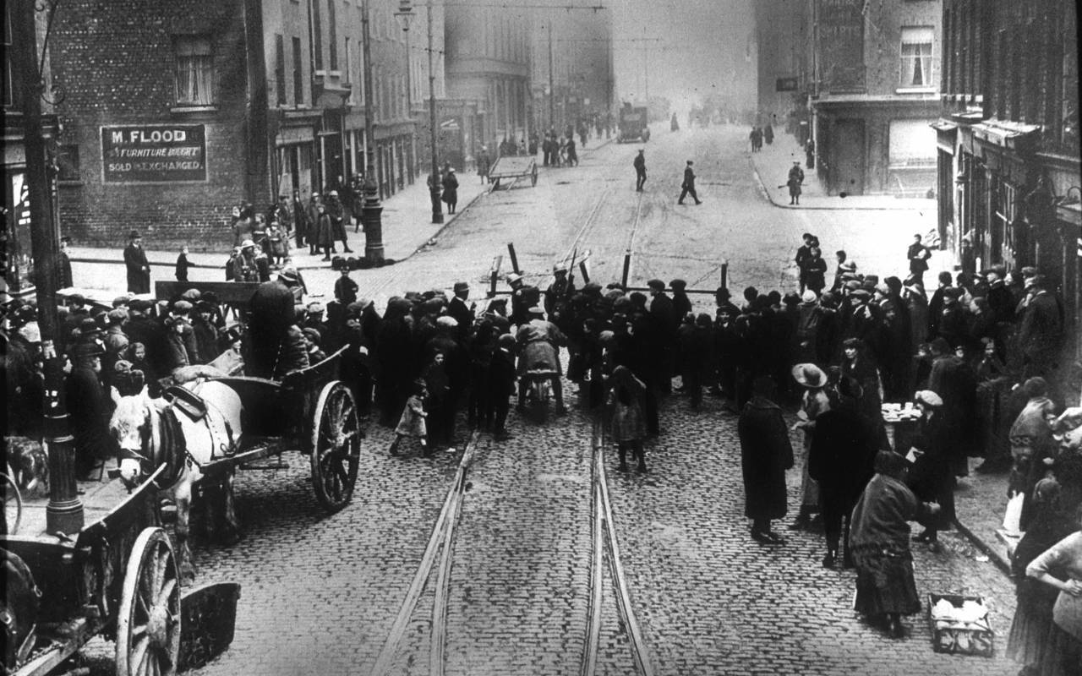
Easter Rising (April 1916)
M. Bourdeau UJML3 2020-2021
Harsh repression of ER + 1918 conscription crisis => most Irish people started supporting independence more than Home Rule.

Slide 9
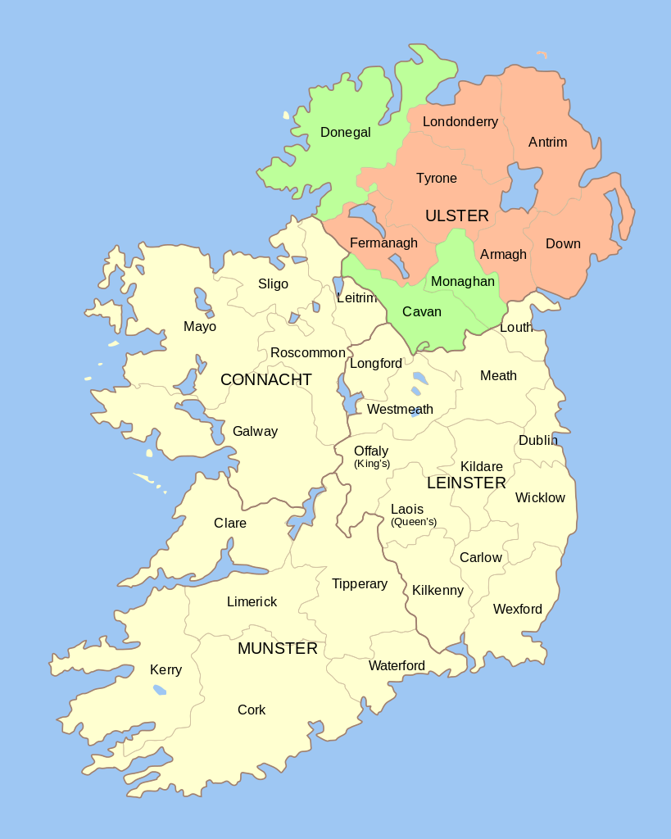
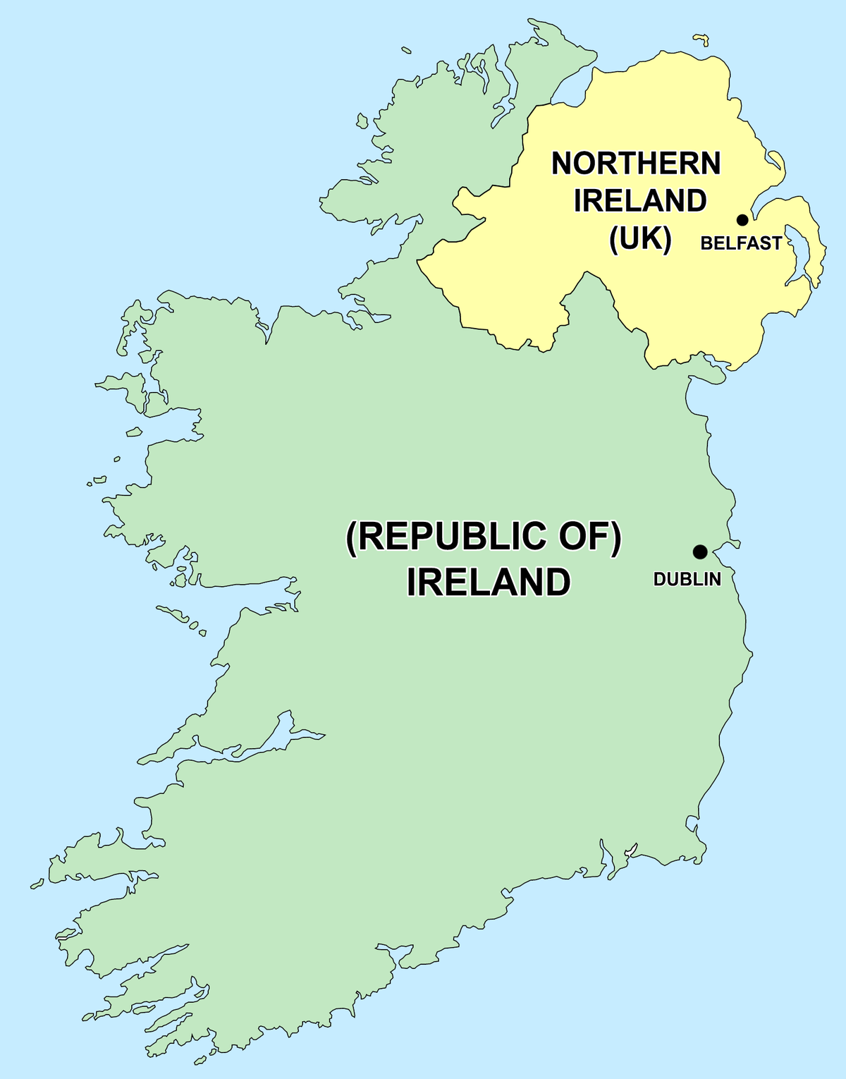
Partition
1918 general election: landslide victory for Sinn Féin in Southern Provinces =>
First Dáil Éireann + Declaration of Independence
BUT in Ulster: Unionist victory = clear gap bet U & rest of Ireland
1919-1921: Anglo-Irish war for independence
1921: partition & creation of separate Home Rule Parliaments in Dublin and in Northern Ireland.
(The Dublin Parliament/ Home Rule in the South was never implemented as the self-governing Irish Free State was established in 1922).
M. Bourdeau UJML3 2020-2021

Slide 10
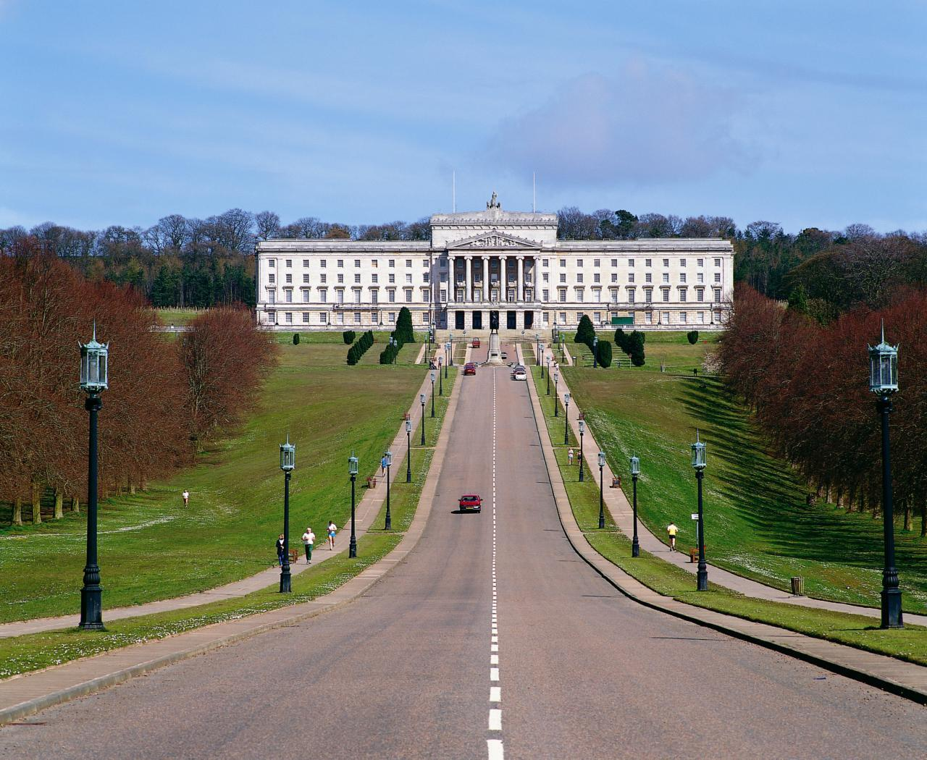
The Parliament of NI
Nickname: ‘Stormont’
Set up by the Government of Ireland Act 1920
Was active from 1921 to March 30th 1972
Protestant domination throughout (majority = Ulster Unionist Party)
was then suspended because of the Troubles => direct rule by London / the Northern Ireland Office
was officially abolished under the Northern Ireland Constitution Act 1973.
1972-1998: Intermittent home rule through various forms of Northern Ireland Assembly, trying to balance representation of unionist (/mostly Protestant) and republican (/mostly Catholic) rights.
M. Bourdeau UJML3 2020-2021

Slide 11
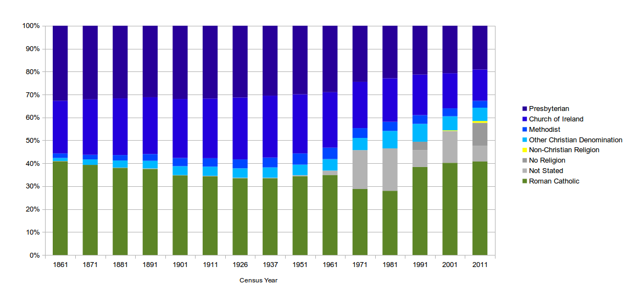
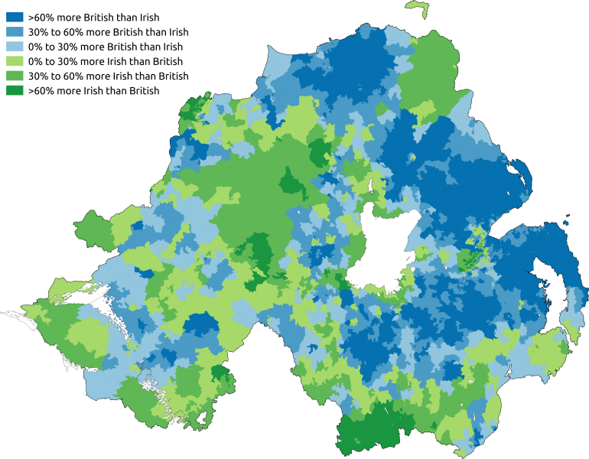
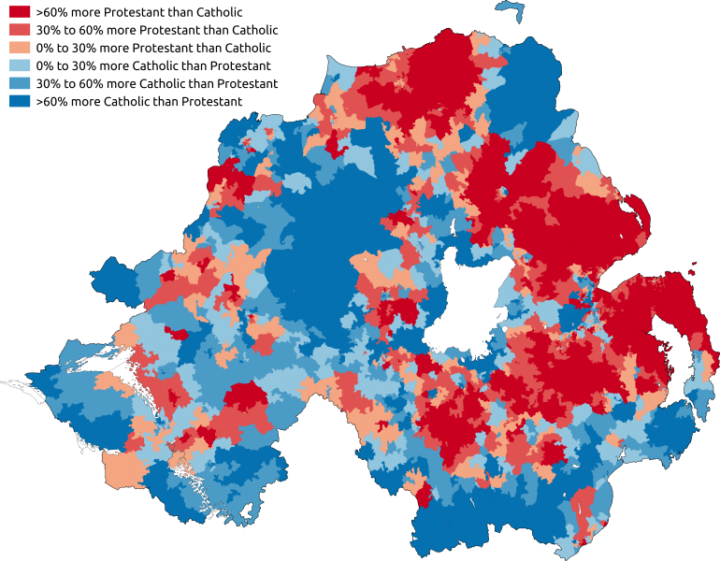
Map of predominant national identity (2011)
Map of religion (or religion brought up in) (2011)
M. Bourdeau UJML3 2020-2021
=> Still today, religion & sense of national identity = tightly interwoven /mostly synonymous

Slide 12
NI politics & society 1921-1970s:
Population = mainly Protestant.
Presbyterians + Church of Ireland
Protestants = mostly Unionists
Catholics (35% of the population in the 1961 census).
Unemployment
Emigration
Catholics = mostly nationalists
Institutionalized separation of the two communities through gerrymandering (manipulation of voting district boundaries)
Economic dimension
Discriminating legislation against Catholic community (access to jobs, services etc) by the Unionist/Protestant government
Political lack of representation for Catholics
M. Bourdeau UJML3 2020-2021

Slide 13
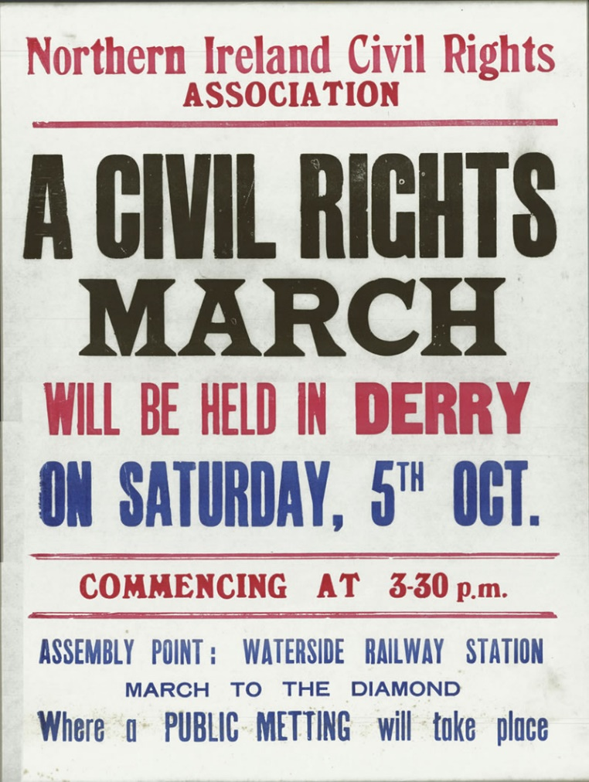
NI politics & society 1921-1970s:
1967-69: non-sectarian civil right movements created to protest discrimination (especially against Catholics); opposed by loyalist ultra-Protestant groups (ex. UVF)
UVF offensives to discourage unionist government from negotiating with NI Catholics & Dublin.
Some CRM leaders became involved in nationalist /republican movements
From 1969 on, growing tensions:
Escalating police brutality (ex: Oct. 5th 1968 Derry March)
Increased tensions with /attacks from Protestant paramilitary groups (Belfast, Derry => August 1969 ‘Battle of the Bogside’)
Militarization of conflict (UVF vs. IRA) + British troops sent to Ulster
The IRA took over CRM associations as ‘defender’ of Catholics
M. Bourdeau UJML3 2020-2021

Slide 14
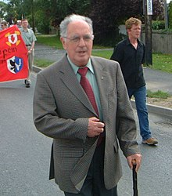
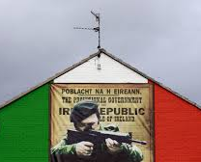
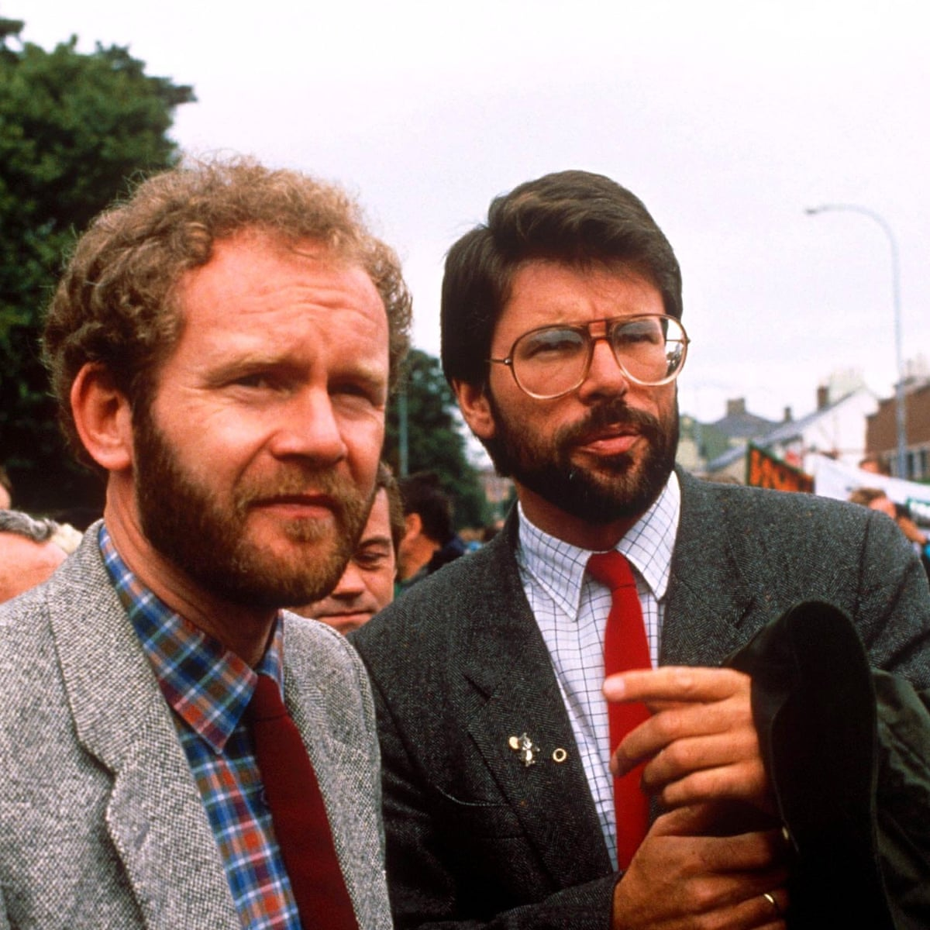
2. The ‘Troubles’ / Na Trioblóidí
The (Provisional) Irish Republican Army (IRA)
/ Óglaigh na hÉireann (‘soldiers of Ireland’)
Irish Republican paramilitary group
Main objectives since 1969:
Protect Catholic community from attacks by ultra Protestant groups
End British presence & rule in Northern Ireland
Irish reunification + establishment of a socialist Irish Republic
Guerilla tactics => highly controversial:
Considered a terrorist group by the UK
Declared illegal in the Republic of Ireland
Relation with Sinn Féin?
Overlapping interests & goals & often overlapping membership
Some senior members of SF allegedly part of PIRA’s Army Council
Ruairí Ó Brádaigh (established)
Gerry Adams (alleged/denied)
Martin McGuinness (alleged/denied)
M. Bourdeau UJML3 2020-2021

Slide 15
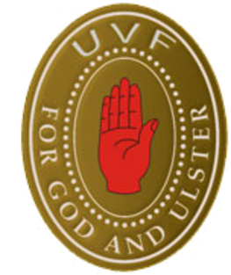
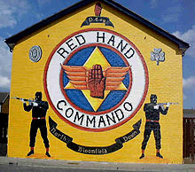
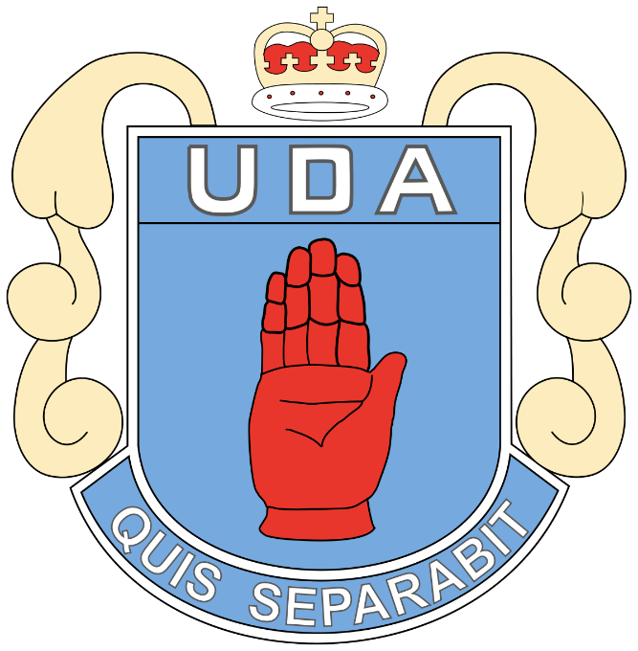
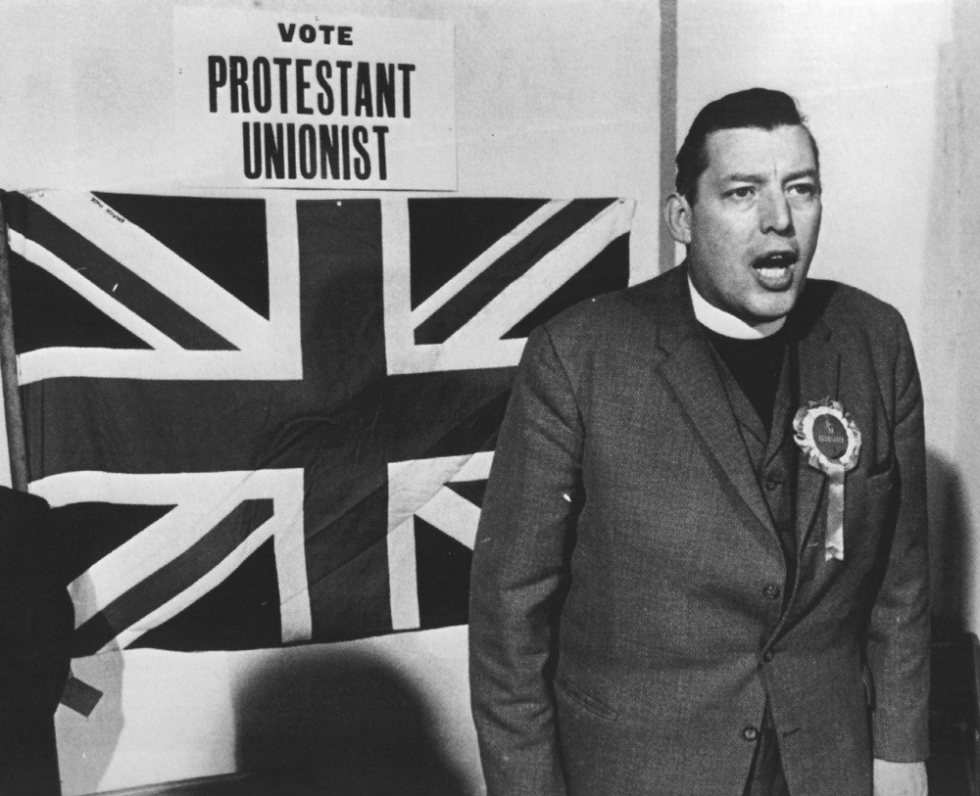
vs. Ulster loyalists
= NI Protestants opposing Catholic emancipation (18-early 20th cent), Irish independence (20th cent) & NI independence from the UK (20th-21st cent)
Paramilitary groups ex
the Ulster Volunteer Force (UVF) (considered a terrorist group by the UK since 2000)
Ulster Defence Association (UDA) /Ulster Freedom Fighters (UFF) (considered a terrorist group by the UK since 1992)
the Red Hand Commando (RHC) (considered a terrorist group by the UK since 2000)
Political parties
Ulster Democratic Party (1981-2001); links with the UDA
Progressive Unionist Party (1979-): links with the UVF and the RHC
Democratic Unionist Party (1971): links with the UVF and the UDA. Created by Ian Paisley.
M. Bourdeau UJML3 2020-2021

Slide 16
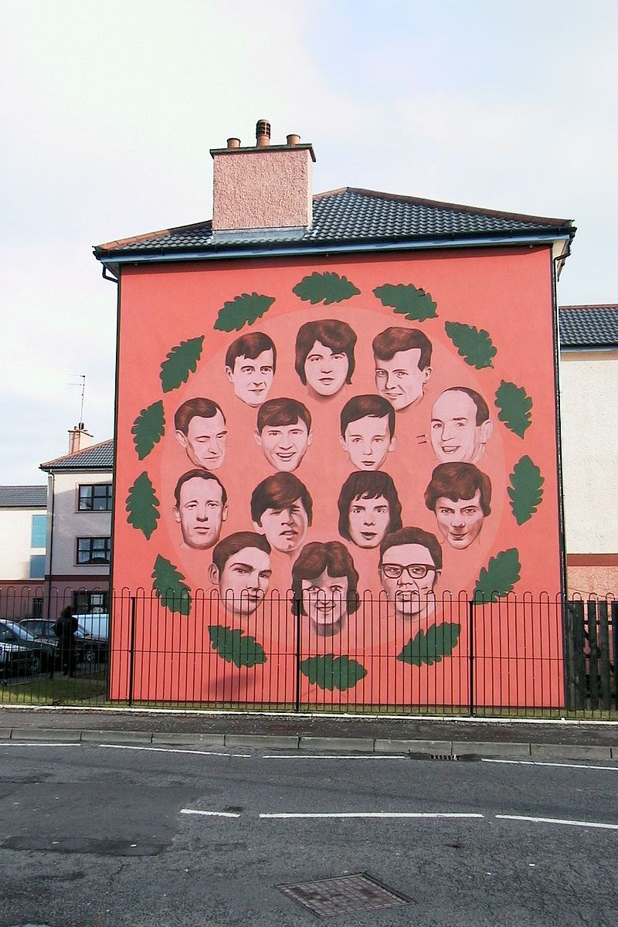
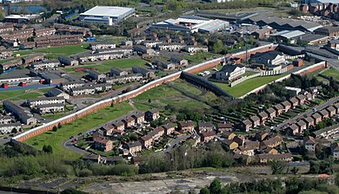
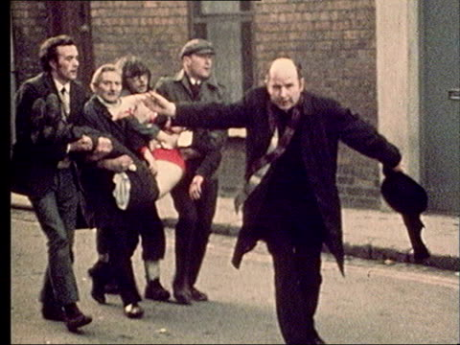
1969:
deployment of British troops against CRM movements
“Peace Walls” built (Belfast, Derry)
1971: ‘Operation Demetrius’:
internment (detention without trial) for suspected IRA members
torture-like interrogation methods
=> huge backlash & protests
1972:
deadliest year (500 casualties, half of whom civilians)
30th January in Derry: ”Bloody Sunday” (anti-internment march) => 14 unarmed protesters shot dead by British paratroopers
Fuelled Catholic & Republican hostility against the Brits & British troops in particular
Renewed support for the IRA
M. Bourdeau UJML3 2020-2021

Slide 17
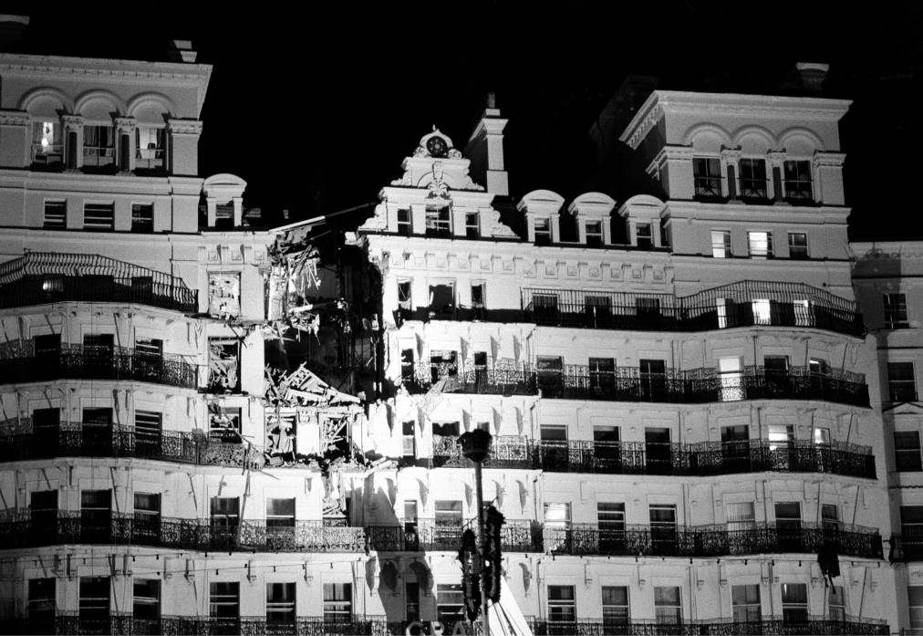
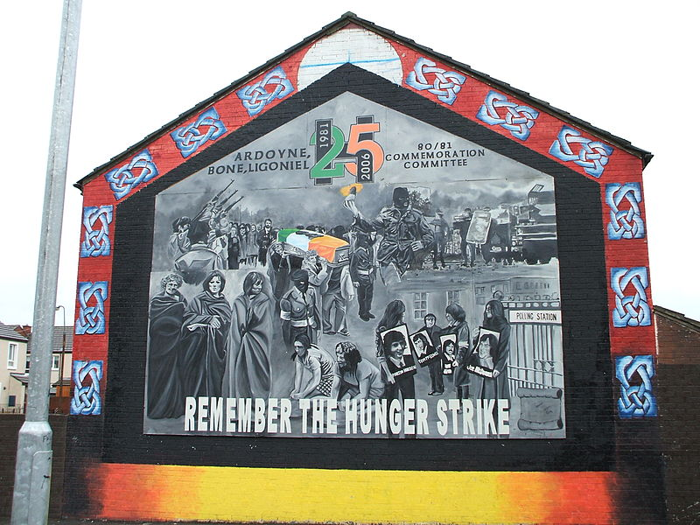
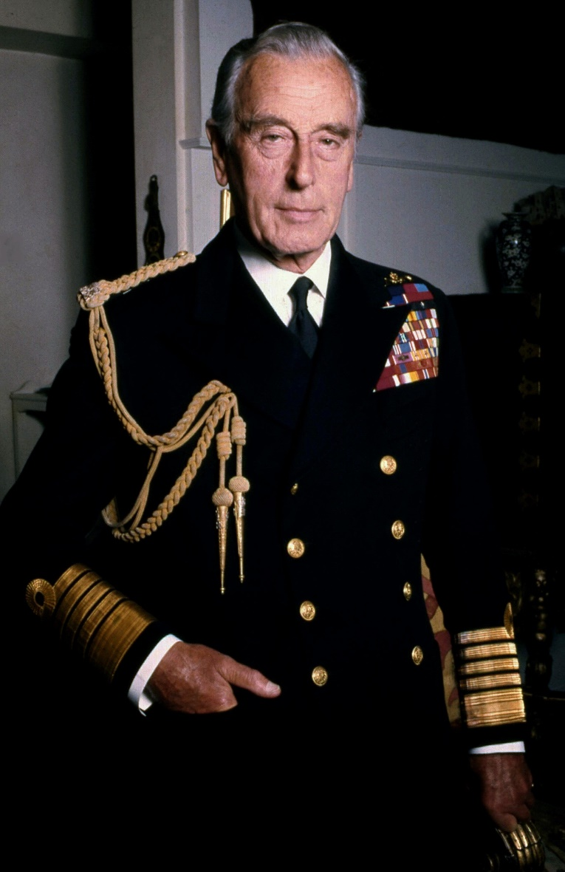
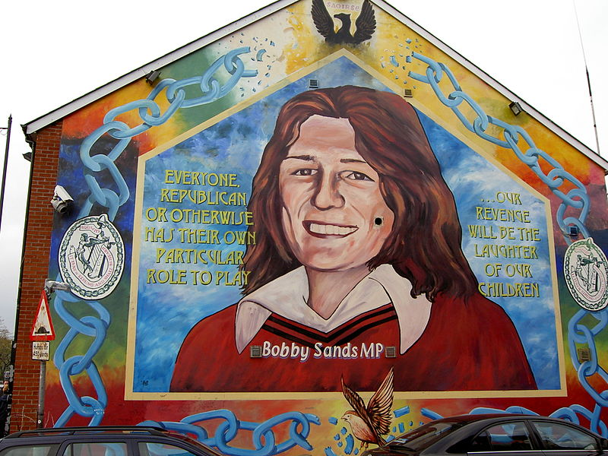
Unionist-controlled Stormont unable to manage the situation / restore peace => Northern Ireland (Temporary Provisions) Act 1972) =>
suspension of the NI Parliament
“direct rule” from London (supposedly a short term measure but lasted well into the 1990s)
Successive British gov. failed to find a solution
Political & military deadlock => the Troubles continued throughout the 1970s, 1980s, and the 1990s
1969-1994: 3,000 people killed
Republican/Catholic-controlled "no-go areas" in Belfast and Derry
Strikes, bombings & attacks from/on both sides
1979: PIRA attack killed Lord Mountbatten (last Viceroy of India/ Prince Philip’s uncle)
1981 Hunger strike (ten prisoners died, incl. Bobby Sands) => escalation of violence
1984: Grand Hotel in Brighton (where politicians including Thatcher, were staying for the annual Conservative Party conference) bombed => conflict even outside NI
M. Bourdeau UJML3 2020-2021

Slide 18
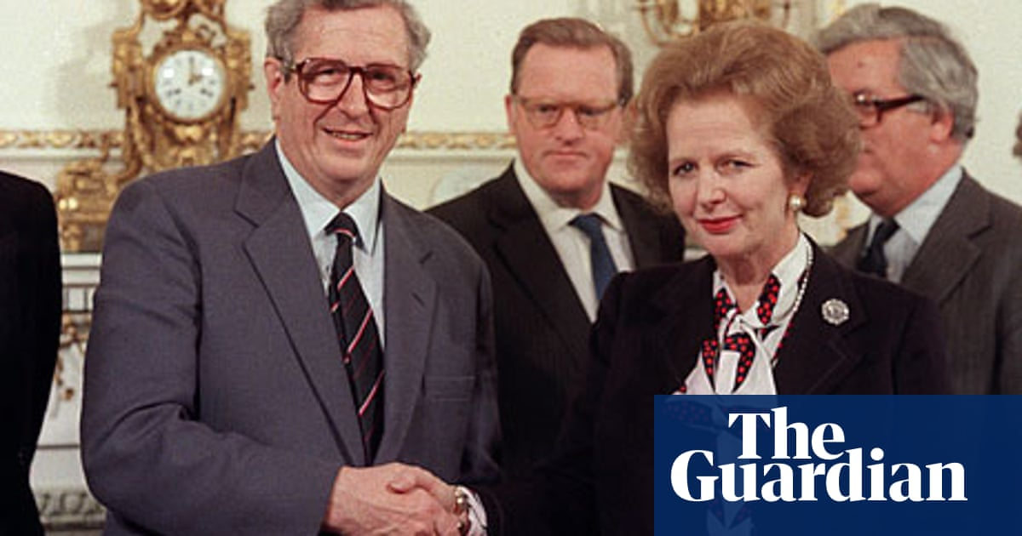
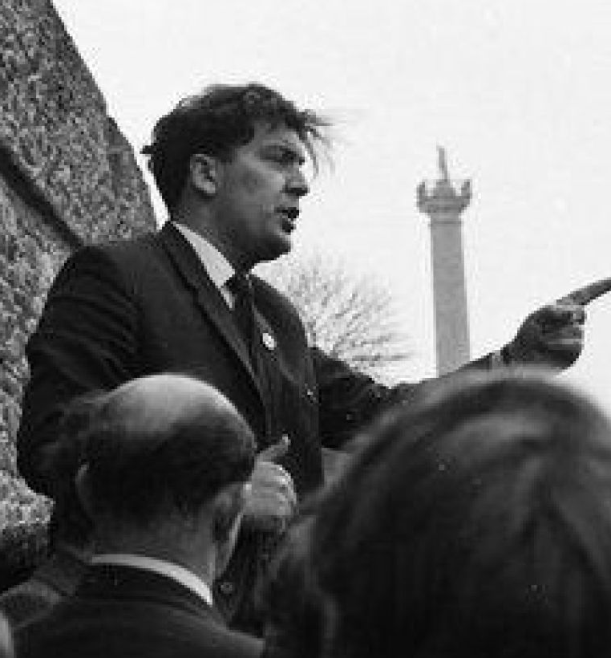
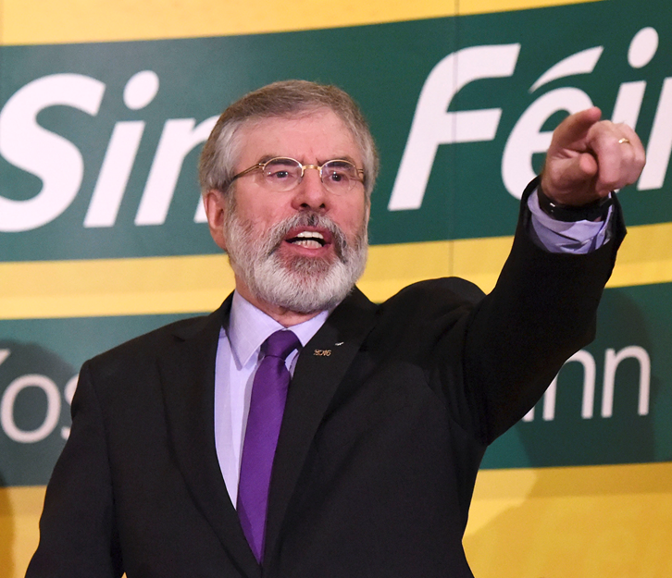
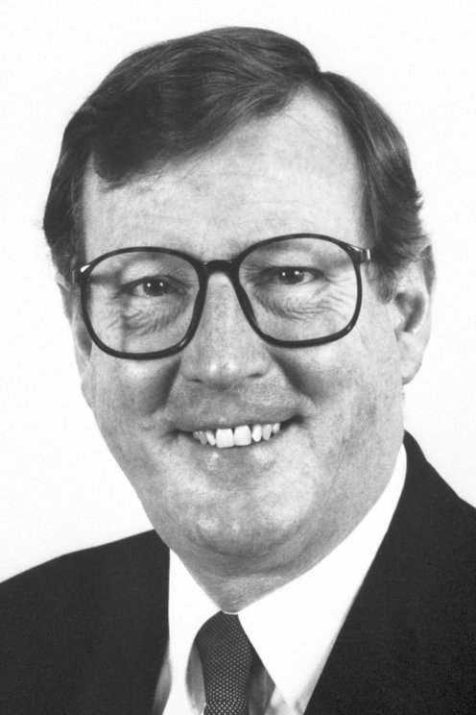
Late 1980s-early 1990s: still attacks & violence but need for a solution for both sides
Sinn Féin (led by Gerry Adams) started advocating for peace & +/- secretly working on a (long) peace process.
Loyalists also engaged behind-the-scenes talks to end the violence
John Hume (Irish nationalist) & David Trimble (Ulster Unionist) (conjoint Peace Nobel Prize in 1998)
Growing international pressure (Brussels, Washington/Reagan <- Irish-American lobbying) => Thatcher had to make concessions
1985: Anglo-Irish agreement between Garret FitzGerald (Irish Taoiseach) & Margaret Thatcher (British PM):
Cooperation between Dublin and London to make decisions regarding NI
Encouraging a NI power-sharing devolved government
Agreement criticized by Unionists (going too far) & nationalists (not going far enough)
Still, improved London/Dublin cooperation = laid ground for the peace process
M. Bourdeau UJML3 2020-2021

Slide 19
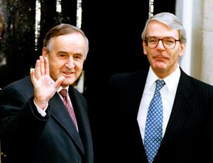
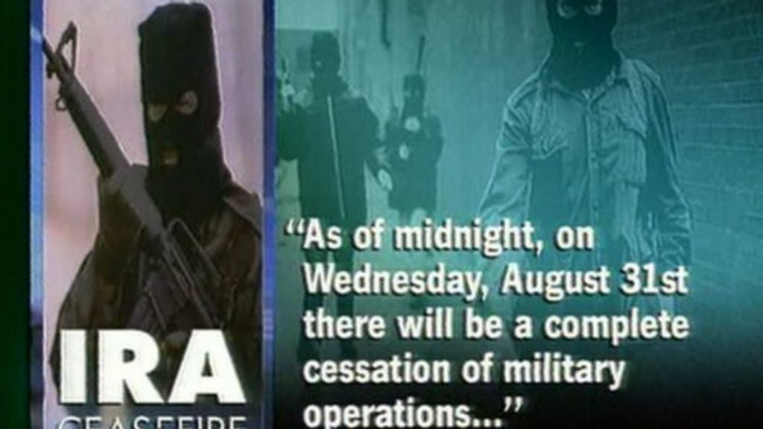
Dec 1993: Downing Street Declaration by UK PM John Major and Taoiseach Albert Reynolds
Right of the people of Ireland to self-determination
Northern Ireland would be transferred to the Republic of Ireland from the United Kingdom only if a majority of its population was in favour of such a move.
Principle of consent : the people of the island of Ireland have the exclusive right to solve the issues between North and South by mutual consent = instrumental in convincing republicans to commit to a negotiated settlement.
Insurance that parties linked with paramilitaries (ex Sinn Féin) could take part in the talks, so long as they abandoned violence.
General popular support
Declaration considered sufficient by the PIRA to announce a ceasefire on 31 August 1994.
October 1994: Protestant ceasefire.
M. Bourdeau UJML3 2020-2021

Slide 20
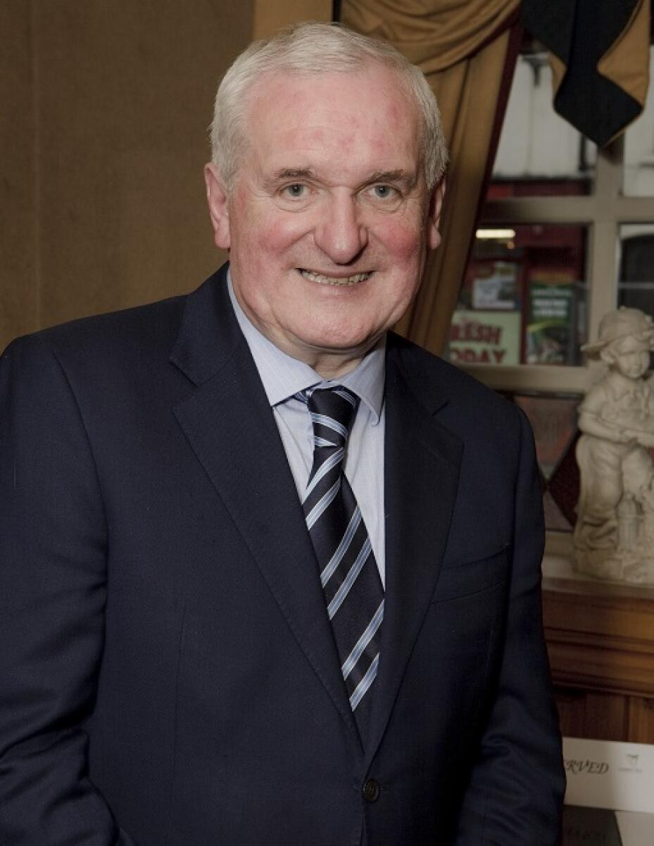
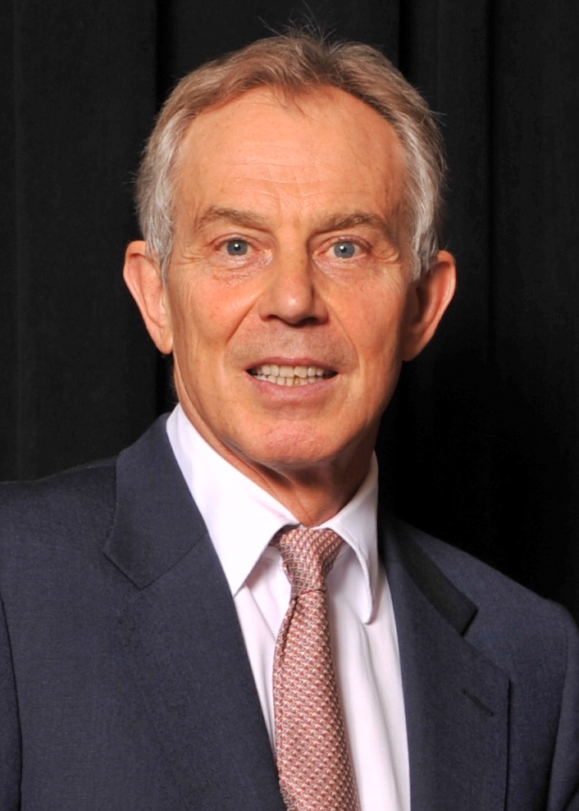
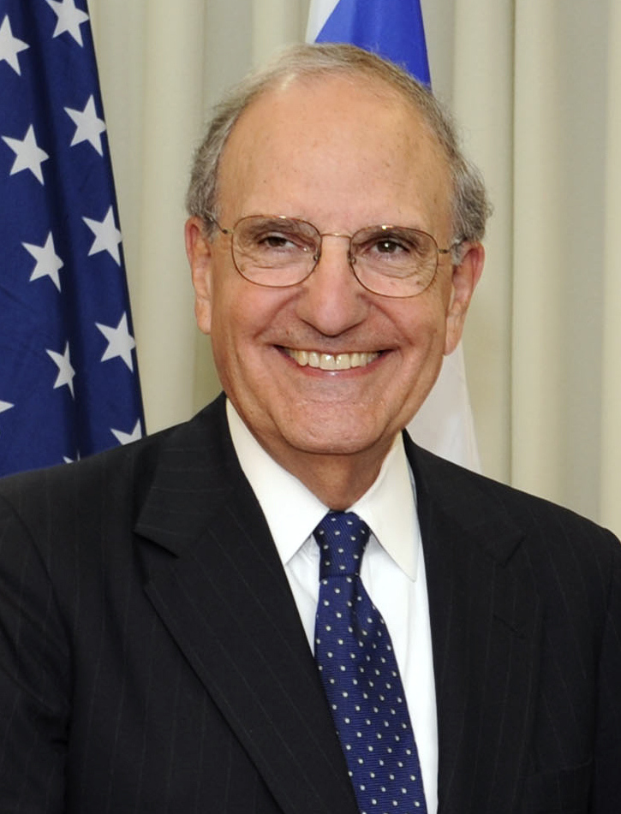
Towards the Good Friday Agreement
1995: Sen. George Mitchell appointed as US Special Envoy for Northern Ireland (= Clinton’s representative for NI)
Feb. 1996: IRA cancelled its cease-fire (blamed on the British Government's refusal to begin all-party negotiations until the IRA had decommissioned its weapons) => Negotiations blocked.
May 1997: Tony Blair became PM => new phase of negociations (without Sinn Féin)
July 1997: IRA ceasefire
Sept 1997: Sinn Fein readmitted to the talks
Main protagonists: Tony Blair (British PM), Bertie Ahern (Irish Taoiseach) & George Mitchell
M. Bourdeau UJML3 2020-2021

Slide 21
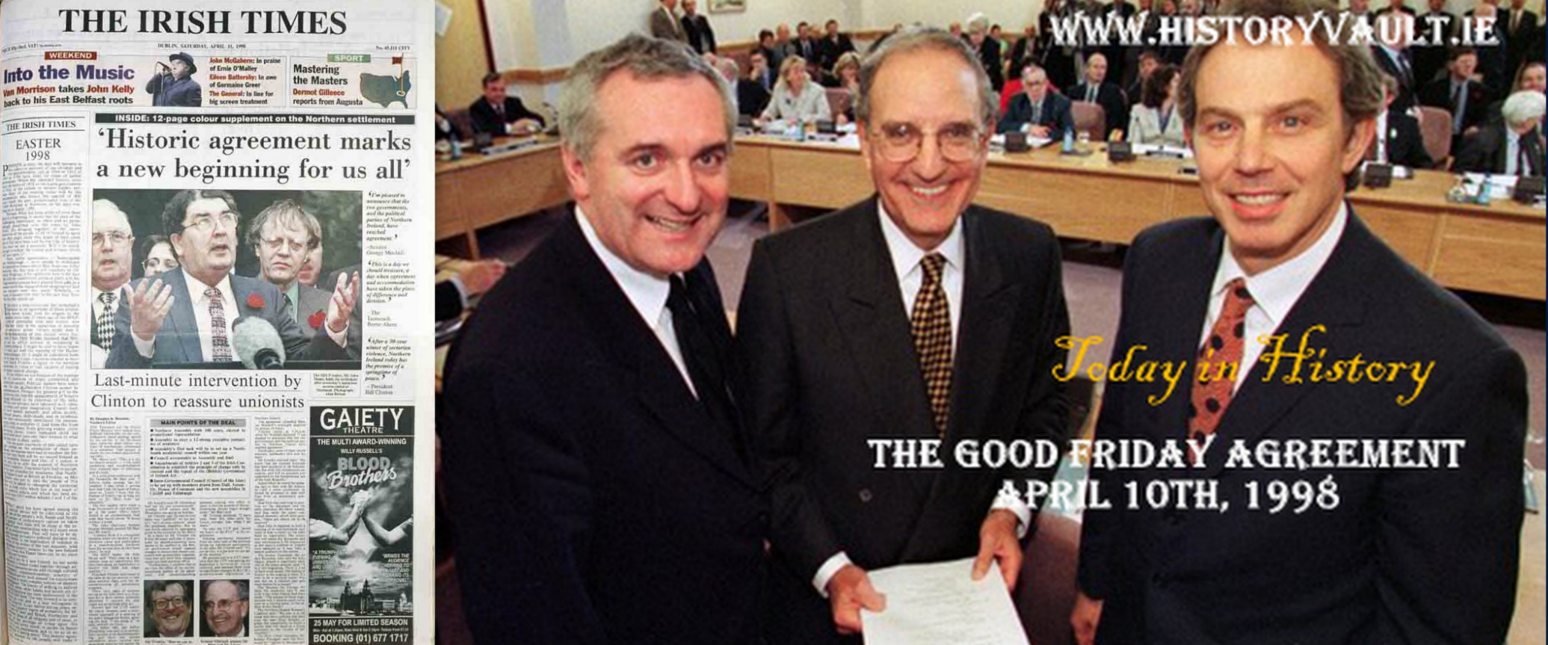
“Three Strands” determining:
The status and system of government of Northern Ireland within the United Kingdom. (Strand 1)
The relationship between Northern Ireland and the Republic of Ireland. (Strand 2)
The relationship between the Republic of Ireland and the United Kingdom. (Strand 3)
The agreement acknowledged the legitimacy of two contradictory claims:
the majority of the people of Northern Ireland wished to remain a part of the United Kingdom;
a substantial section of the people of Northern Ireland, and the majority of the people of the island of Ireland, wished to bring about a united Ireland.
The Agreement recognized
that Northern Ireland = part of the United Kingdom until a majority of the people both of Northern Ireland and of the Republic of Ireland wished otherwise, in which case Brit. & Irish govs = “binding obligation" to implement that choice.
the right of "the people of Northern Ireland" to "identify themselves and be accepted as Irish or British, or both" (as well as their right to hold British or Irish citizenship or both)
The Agreement also imposes
The decommissioning of weapons held by paramilitary groups
The respect of equality & human rights
May 1998: Agreement approved in a referendum
10th April 1998: The Good Friday Agreement (/’Belfast Agreement’)
M. Bourdeau UJML3 2020-2021

Slide 22
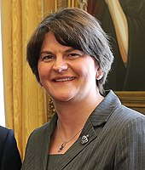
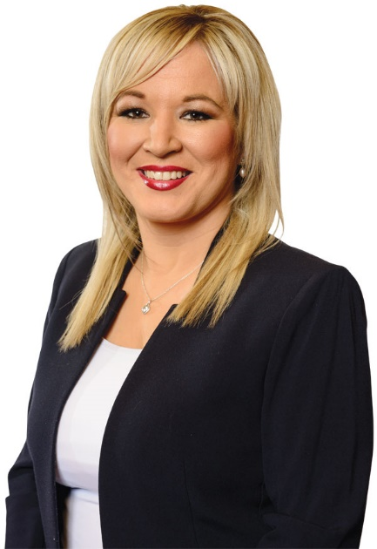
Northern Irish Government
Power-sharing principle: unionists (DUP) & nationalists (Sinn Féin) must both participate in governing the region = ‘mutually inter-dependent’ system
First Minister (one party) and deputy First Minister (other party)
Since 2020: First Minister = DUP’s Arlene Foster + Deputy FM = SF’s Michelle O’Neill
‘D’hont formula’ to appoint ministers:
ministerial portfolios are divided among the parties in proportion to their strength in the Assembly
Exception: Minister of Justice, elected by a cross-community vote in the NIA
NI Executive is answerable to the Assembly
Ministers have to participate fully in
the devolved Executive
the North/South Ministerial Council
the British-Irish Council
M. Bourdeau UJML3 2020-2021

Slide 23
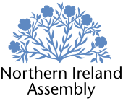
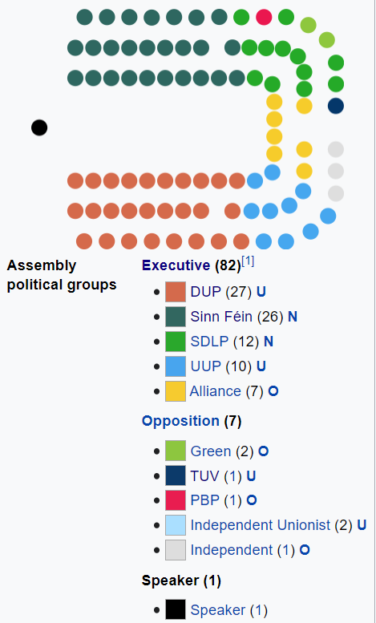
Northern Irish Assembly/Stormont
Established by the Northern Ireland Act of 1998
Devolved legislature of NI => devolved & restricted matters
Unicameral
18 constituencies; 90 seats
90 MLAs (Members of the Legislative Assembly / Comhaltaí den Tionól Reachtach)
Proportional representation
Some executive positions & contentious motions require a cross-community vote to be approved
M. Bourdeau UJML3 2020-2021
Notes:
/ˈkɒltɪ den tjəˈnɒl ɾʌhktə/

Slide 24
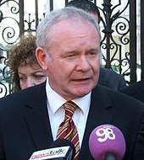
Northern Irish Assembly/Stormont
5 suspensions, incl. 3 very short ones (2000, 2001x2) and two longer ones:
14 October 2002 – 7 May 2007 : disagreement on formation of the executive
Unionist withdrawal => suspension
Direct rule from London
2006: Saint Andrew’s agreement: DUP & SF agreed to power-sharing => Ian Paisley (DUP) as First Minister and Martin McGuinness as deputy First Minister (SF). First Assembly to complete a term.
9 January 2017 – 11 January 2020: new breakdown
Renewable Heat Incentive scandal involving DUP First Minister Arlene Foster
Resignation of Sinn Féin Deputy First Minister Martin McGuinness in protest => Foster removed from position
Elections in 2017 but failure to form an Executive (disagreements bet DUP & SF over social issues ex. abortion, official status of the Irish language, same-sex marriage)
Eventual restoration in 2020
Towards a new suspension? Feb 2021: DUP MLAs threatened to bring down the Assembly in protest at the Brexit deal setting a NI/UK border in the Irish Sea (‘NI Protocol’)
M. Bourdeau UJML3 2020-2021

Slide 25
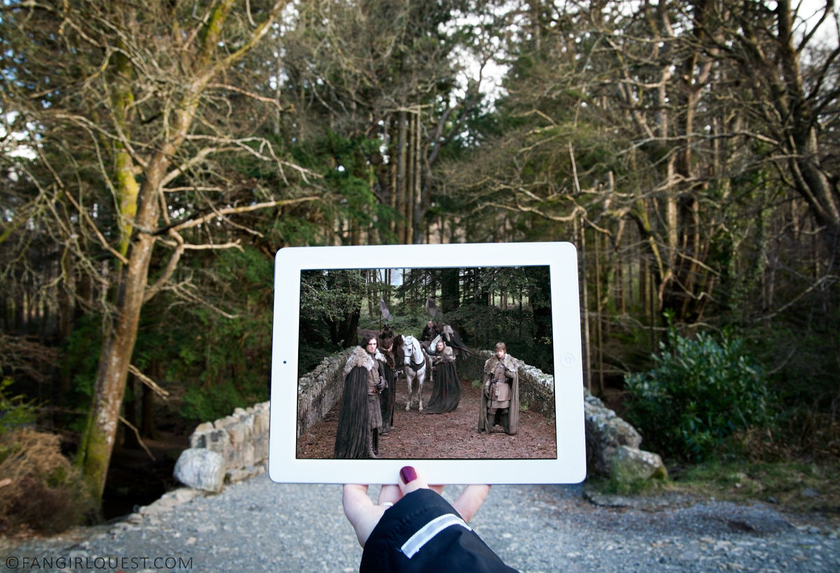
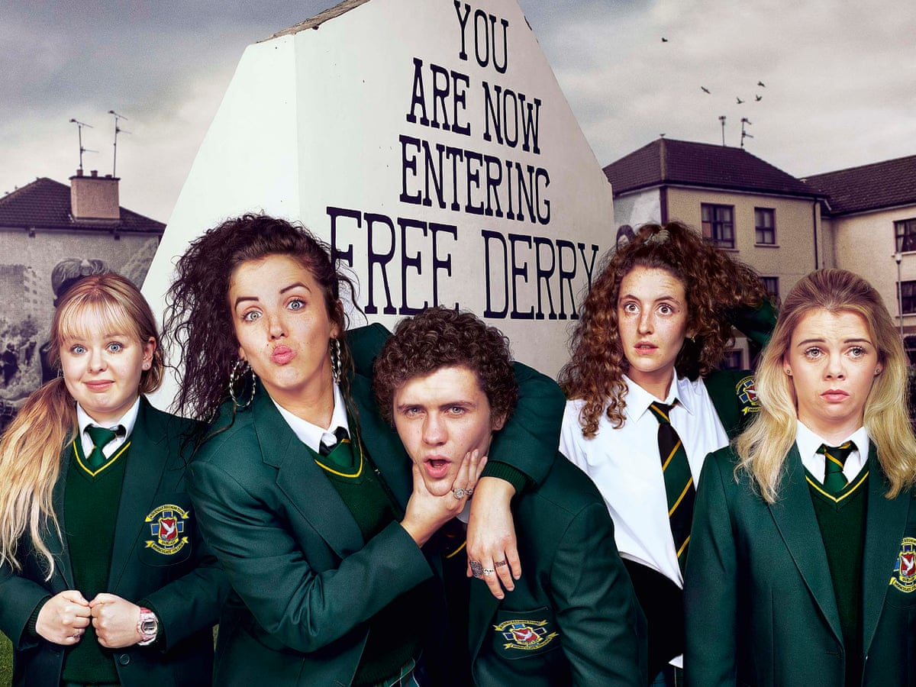
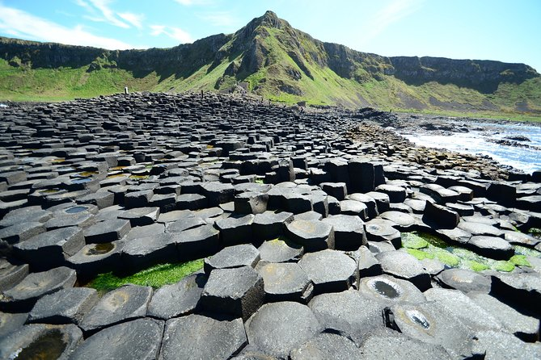
3. What Future for Northern Ireland?
Northern Irish Economy
1990s: Peace Agreement & end of the ‘Troubles‘: relative peace =>
cultural vitality, pride and optimism
economic development
IT industry (traditionally: shipbuilding, rope manufacture & textiles)
Replaced by services:
Public sector (70% of the economy)
Tourism (4.9% of NI’s GDP / over 40,000 jobs): landscapes & castles, ‘Troubles tourism’, film tourism
Local film industry: Game of Thrones, Derry Girls
M. Bourdeau UJML3 2020-2021

Slide 26
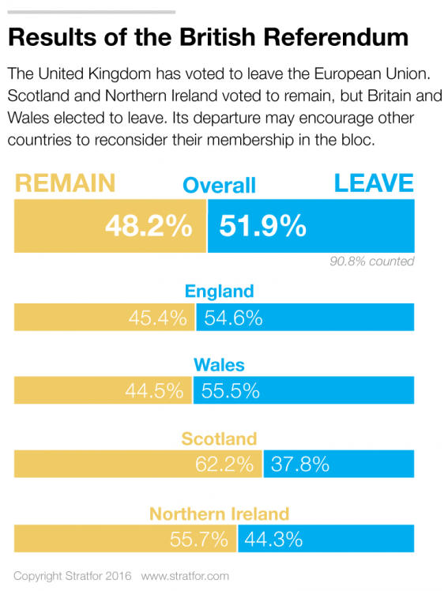
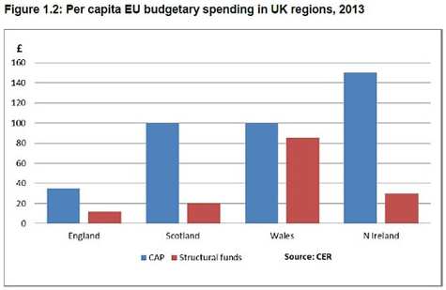

Northern Ireland & the EU
Major role of the European Union
In NI’s politics / 1998 peace process
In NI’s economy
€2.8bn in the last EU funding round
€2.2bn more by 2020
90% of Northern Irish farmers’ income
Cross-border programmes
Intertrade, Peace and Tourism Ireland
Erasmus programme
Good integration in the EU
2016 Brexit vote
huge shock for NI
55.7% vote to Remain in NI
M. Bourdeau UJML3 2020-2021

Slide 27
Consequences of Brexit on NI = ?
Withdrawal of EU funds NI heavily relied on
Threatens the precarious balance reached through the Good Friday Agreement & creates risk of renewed tensions due to custom checks
Ex: pb of the Border => unsolvable Brexit Trilemma;
no hard border on the island
no customs border in the Irish Sea
no British participation in the European Single Market and the European Union Customs Union
Long & tense negotiations bet. British PMs (May, Johnson) & Irish Taoisigh (Enda Kenny, Leo Varadkar, Micheál Martin)
Controversial Northern Ireland Protocol (rejected by Unionists)
M. Bourdeau UJML3 2020-2021

Slide 28


After Brexit: towards reunification?
Democratic Unionist Party (DUP), pro-Leave
don’t agree with BJ’s deal with the EU
complex position as Brexit threatens unionism / some U feel abandoned by the British gov.
Sinn Féin’s reaction to Brexit:
leader Mary Lou McDonald calling for a referendum on reunification with the Republic of Ireland
Calls for referendum rejected by Brit. gov. & Unionists (argument: no evidence that opinion in Northern Ireland had shifted towards reunification)
But 2017 Assembly election=> the DUP lost ten seats (only one seat ahead of Sinn Féin)
April 2017: European Council => in the event of Irish unification, "the entire territory of such a united Ireland would [...] be part of the European Union”
Turning points? Jan 2021:
Polls: 51% of the NI population support a referendum on reunification in the next five years
In NI, 47% still want to remain in the UK (65% pre-Brexit) vs.42% now in favour of a United Ireland (17% pre-Brexit)+ 11% (big portion) undecided (17% pre-Brexit): not ready yet but soon?
In the Republic, 65% in favour of a united Ireland (vs.19% against) (May 2019 RTÉ/REDC poll)
To be continued…
M. Bourdeau UJML3 2020-2021

Slide 29
To sum it all up…
Vignette Arte (série « Stories of Conflict ») :
« Avec le Brexit, à quoi va ressembler la frontière entre Irlande et Irlande du Nord, sous contrôle des Britanniques ? Du 12ème siècle au « deal » signé par « Bojo » pour sortir de l’UE, en passant par ce que l’on a appelé pudiquement les « troubles » entre nationalistes et loyalistes, retour, en cette période mouvementée, sur l’histoire des Irlandais… et des Irlandais. »
https://www.arte.tv/fr/videos/091347-001-A/stories-of-conflict-l-irlande/
M. Bourdeau UJML3 2020-2021

